Slide 1

Joy in Practice:
Reconnecting with the Meaning and Mission of our Work
Medicine Grand Rounds
Christine A Sinsky, MD, FACP
Nov 14, 2014

Slide 2
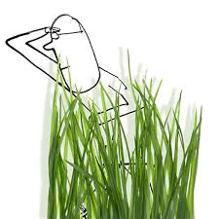
Agenda
Introduction
  Burnout
Meaning and Mission
  Unravel the knot keeping us from meeting our highest intentions
  Focus on impact of Documentation/Regulation
  Mismatch between training and work
Recommendations
  High level multiple actors in healthcare ecosystem
  Gradwhol Art of Primary Care: innovations at practice level
Discussion
Notes:
for different actors within the healthcare system to help “reboot the system for service and satisfaction.”

Slide 3
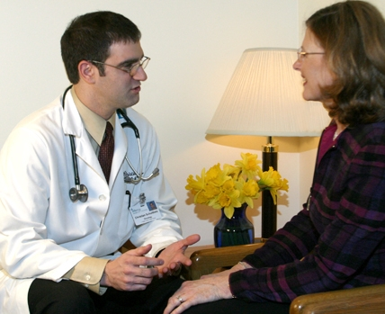
Joy → Triple Aim
Take away
Engaging physicians
Unleash professionalism
Better care
Better health
Lower cost
Notes:
has to be part of the solution to achieving

Slide 4
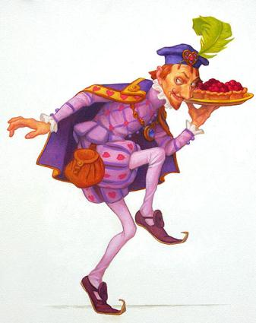
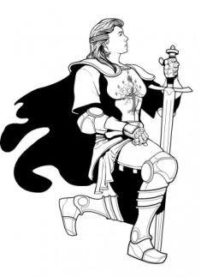
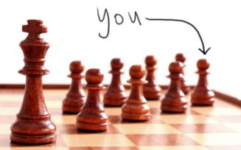
Knights, Knaves or Pawns
Core Q: How can external environment approach nurses/physicians more as
Approach nurses and MDs as knaves and you will eventually get knave-like behavior
imbalance
JAMA. 2010;304(9):1009-1010 (doi:10.1001/jama.2010.1250)
I

Slide 5
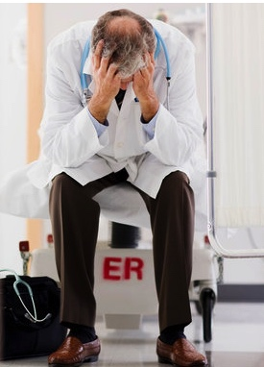
Nearly ½ of MDs Burned Out
Arch Intern Med 2012; E1-9
70% PCP would not choose again
Calculus: spending d doing wrong work
Notes:
“more than half of the doctors in family medicine, emergency medicine and general internal medicine experienced some form of burnout”
recommends restructuring clinics “ …so that doctors could spend more time with patients and … less time in front of a computer completing administrative tasks.”
The doctors’ burnout appeared to have little to do with hours worked or even the ability to balance personal life with work. Instead, the only factor predictive of a higher risk was practicing a specialty that offered front-line access to care. More than half of the doctors in family medicine, emergency medicine and general internal medicine experienced some form of burnout.
Rec: “Restructure …so that doctors could spend more time with patients and … less time in front of a computer completing administrative tasks.
What patients must face in the examining room is no less alarming. Doctors who are suffering from burnout are more prone to errors, less empathetic and more likely to treat patients like diagnoses or objects.

Slide 6
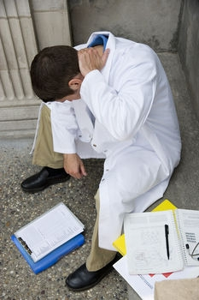
Burnout affects Patients
Physician burnout is associated with…
  ↑ Mistakes
  ↓ Adherence
  Less empathy
  ↓ Patient satisfaction
Sources: Dyrbye. JAMA 2011;305:2009-2010.; Murray, Montgomery, Chang, et al. J Gen Intern Med 2001;16:452–459.;
Landon, Reschovsky, Pham, Blumenthal. Med Care 2006;44:234–242.
Notes:
Tait Shanafelt, MD, Professor of Education and Medicine at the Mayo Clinic, opened the meeting by presenting stark findings on physician burnout and its impact on professionalism. Burnout is characterized by depersonalization, emotional exhaustion, and low personal accomplishment, and is often a result of excessive workload, poor work/life balance, and lack of feelings of control and purpose in one’s work. Burnout among physicians emerges during the second year of medical school and remains a risk throughout training and into medical practice. Dr. Shanafelt vividly described the consequences of physician burnout. In addition to an emotional toll that may lead to depression and suicide, burnout leads to reduced medical student professionalism. Physicians experiencing burnout are also less likely to report impaired colleagues, and these characteristics of burnout have been associated with higher odds of major medical errors among surgeons.

Slide 7
Burnout May Cost US Healthcare
Physician burnout is associated with…
  Fewer PCPs
    Leave practice: 4x rate
    Replace: $250,000
Bylsma, et al. J Gen Intern Med 25(10):1020-3; Linzer et al. Ann Inter Med 2009;151:28-36; Sox Ann Intern Med. 2006;144:57-58
Buchbinder SB et al. Estimates of costs of primary car physician turnover. Am J Man Care Nov 1999:5(11):1431-1438
Notes:
And fewer PCPs by itself is associated with higher costs and lower quality.

Slide 8
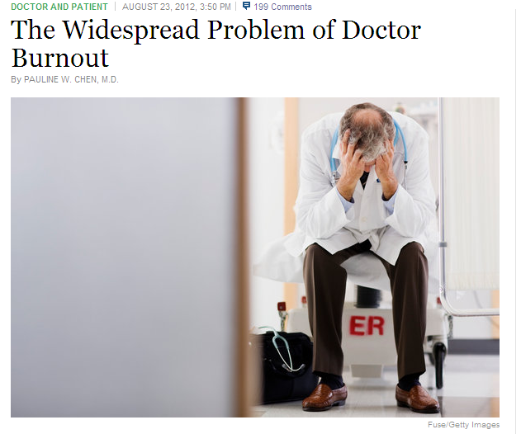
http://well.blogs.nytimes.com/2012/08/23/the-widespread-problem-of-doctor-burnout/
1 in 2 US physicians burned out implies origins are rooted in the environment and care delivery system rather than reflecting weakness on part of a few susceptible individuals.
Notes:
So what is going on in the external environment?

Slide 9
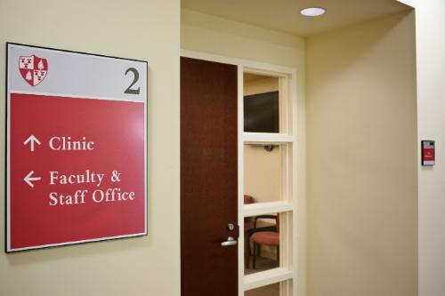

50+ clinics
Obs: 70-80% work effort,
Not add value or not need done;
Ingrained, invisible
½ Re-engineering
½ Mismatch policy/tech
Ultimately hopeful
Solvable problems
Individual can’t solve alone
By coming together, understand fit
multiple stakeholders can make a signif impact.
=
Notes:
And yet this is ultimately a hopeful message. These are solvable problems. A single physician or individual clinic cannot always solve these on their own, but multiple stakeholders, coming together and understanding how the pieces fit together, can make a significant impact.

Slide 10
Three Studies and an Email

Slide 11
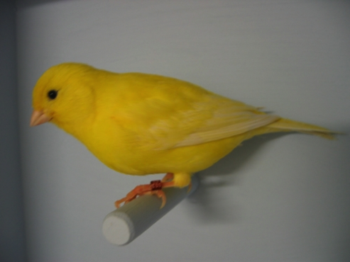


Physician Career Satisfaction
  Quality: Major Driver of Satisfaction
  Dissatisfaction: Early warning sign of dysfn
http://www.rand.org/news/press/2013/10/09.html
Notes:
EHRs decrease physician satisfaction.
interferes with face-to-face discussions with patients,
requires physicians to spend too much time performing clerical work
and degrades the accuracy of medical records by encouraging template-generated notes.

Slide 12
Physician Career Satisfaction
EHR: Major Driver of Dissatisfaction
  Too much time per task, clerical
  ↓ Face-to-face time
  ↓ Quality of visit note
http://www.rand.org/news/press/2013/10/09.html
Notes:
EHRs decrease physician satisfaction.
interferes with face-to-face discussions with patients,
requires physicians to spend too much time performing clerical work
and degrades the accuracy of medical records by encouraging template-generated notes.

Slide 13
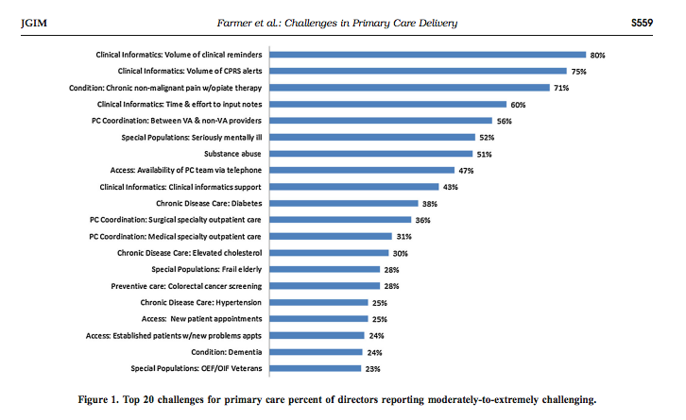
Top 3 of 4 PC Challenges: EHR
VA
JGIM 2014 29(Supple 2):S555-62

Slide 14
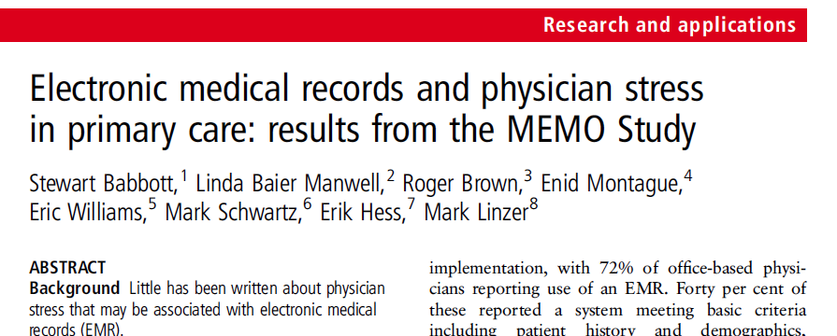
↑ EHR Functions → MD Burnout and intent to leave practice
JAMIA 2013
Fn’s: e-mail, order entry, alerts, reminders, e-communication with colleagues
4
    http://jamia.bmj.com/content/early/2013/09/04/amiajnl-2013-001875.short?rss=1

Slide 15

“I am no longer a physician but the data manager, data entry clerk and steno girl. I am frustrated, unhappy and I am unable to do my best in caring for my patients. I became a doctor to take care of patients. I have become the typist.”
physician, Boston 2013
Notes:
I am no longer a physician but the data manager, data entry clerk and steno girl. I am frustrated, unhappy and I am unable to do my best in caring for my patients. I enjoy solving problems. I became a doctor to take care of patients. I have become the typist.”

Slide 16
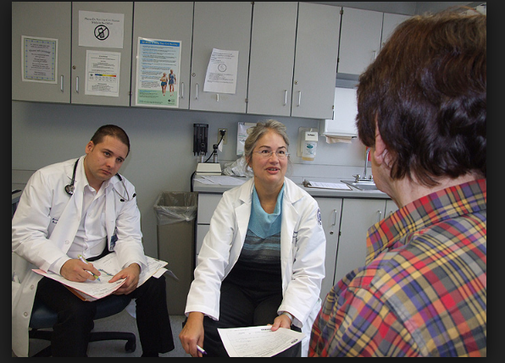

Working in clinic has become so painful that I have decided to leave my beloved patients—unbearable to think about.
Notes:
the change in my clinic from dictated records to EHR (NextGen) has been devastating. I am so glad you are going to be able to give your input in Washington on this topic. Your IM practice is a wonderful model for us.
As a results of adding EHR to our geriatric clinic (average age late 80’s):
- several clinicians have shifted to other sites or left practice entirely
- we can no longer teach medical students due to the time it takes to enter (primarily useless) data
- I now see 4 patients per half-day whereas I used to see 8, and I actually spend less face time with these fewer patients
Working in clinic has become so painful for me that I have decided to leave my beloved patients – unbearable to think about – and spend all my time at SNF and ALF which do not currently use this system. I have used about 8 other EHRs so far and all had major problems except the VA system, which enhances patient care. Of course the VA system is built by a non-profit entity!
Why is the HER a problem? For all the reasons mentioned in the online conversation so far:
-18 clicks to do one function, that we do on each patient -can’t have multiple pages open at the same time to compare findings -to look at past visits can require 75 clicks to find the actual visit, because of all the other entries (phone calls etc), as it did yesterday for one of my patients
- every week we have down time to fix connectivity issues – with printer, with operating system, with Dragon -system focused solely to enhance billing and enter ‘meaningful use’ data which is usually not meaningful to 90 year olds -‘one-size fits all’ mentality which does not work for older folks -no way to enter clinical reasoning unless you free text (which is not ‘counted’) – all of us are now using the free text areas exclusively after year experimenting with the ‘click’ clinical options in HPI, ROS, PE -malpractice issues with the 5+ ‘warning’ messages that you get each time you enter a diagnosis or medicine – we all just click ‘acknowledge’ as it takes too long to read and the messages are not clinically relevant (info overload) -even after 2 visits, the EHR chart is so cluttered with non-information that trying to review past events could take hours, so we often don’t do it -accuracy of entries by unskilled staff (medical technicians) is major problem – they are not skilled in subtleties in taking a medication – or any type of history - in complicated older patients. I have yet to have a chart with correct medication list, which also is a concern medico-legally. The errors are so common and take so long to fix (so many clicks, pages) that I have resorted to now dictating in every record: “The medication and past medical history listed in NextGen are not correct.”
I used to leave clinic around 6:30 pm and feel good about my work and teaching that day, with every chart complete. Now I leave at 11 pm and will still have to spend time on the weekend reviewing and correcting fellow notes (usually about 1.5 hrs/day session, plus many messages – only some of which are relevant to patient care.

Slide 17
Burnout is the sum total of hundreds and thousands of tiny betrayals of purpose, each one so minute that it hardly attracts notice.
http://www.theatlantic.com/health/archive/2014/02/for-the-young-doctor-about-to-burn-out/284005/
Tipping point
Notes:
"Burnout at its deepest level is not the result of some train wreck of examinations, long call shifts, or poor clinical evaluations. It is the sum total of hundreds and thousands of tiny betrayals of purpose, each one so minute that it hardly attracts notice. http://www.theatlantic.com/health/archive/2014/02/for-the-young-doctor-about-to-burn-out/284005/

Slide 18
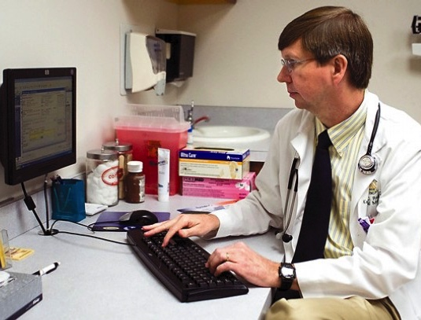
Betrayals of purpose
4000 clicks per day
ER
10 hr shift
44% data entry
4000 clicks
28% pt care
PCPs
11 hr day
50% computer
  COE, inbox
20% patient
  1/3 screen gaze
(work product: pt care or documentation?)
Am J Emerg Med 2014;31(11):1591-1594
Notes:
Only 20% of the day, just a little over 2 hours of the 11 hour day is spent with patients.

Slide 19
  Clinical Documentation
Billing template→pseudotext
  The patient presents with palpitations. The onset was just prior to arrival. The course/duration of symptoms is resolved. Character of symptoms skipping beats. The degree at present is none. The exacerbating factors is none. Risk factors consist of none. Prior episodes: none. Therapy today: none.
  Six pages, no meaning; Pt’s story? Dr’s thinking? Care?
  Like many barriers, etiology complex
    Dr’s fault not typing?
    Administrator
    Compliance?
    EHR vendor?
    Billing rules?
  End result: compromise of clinical quality and efficiency
Notes:
verbatim, typical, ER note in my organization
Those of you in practice will recognize that this is a history obtained on a billing template, composed by clicking through a series of drop-down boxes to create this pseudo text.

Slide 20
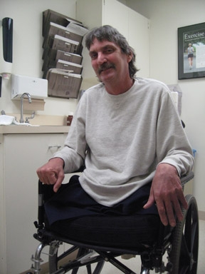
The patient’s story matters
More than waste
Notes:
. And we stop fully listening to the patient.

Slide 21
Listen to your patient, he is telling you the diagnosis.
Sr Wm Osler
Notes:
If we are marching our patients through a series of dropdown boxes to generate discreet data or save on transcription costs I wonder, are we systematically making it more difficult to deeply listen to our patients.

Slide 22
Conceptual Model:
Matching Work to Worker
Calculus: wrong work→ burnout
Y
Worker is under trained for the work
Unsafe
Complexity of work
Sweet spot: worker and work are well matched
Inefficient (Waste)
X
Worker is over trained for the task
Modified from A. Mulley
Training
Notes:
Optimized

Slide 23
Current Work Distribution in PC
High value
Good match
“Solution Shop”
Dx and Rx plan
Complex chronic
Relationship bldg
Shared decision making
Complexity of work
Inbox mgmt
Med rec
“Production Line”
Script renewals
Data entry
Data gathering
PAs
Prior authorization
Script renewals
Sign for hearing aid battery
Vitals
MA
RN
RN
NP
PA
MD
Training
Notes:
Highly trained worker, low complexity work

Slide 24
In few other sectors of the economy is the highest-level professional responsible for the majority of production, customer service, and clerical work.
SGIM Blue Ribbon Panel Report. Redesigning the Practice Model for General Internal Medicine: A Proposal for Coordinated Care. J Gen Intern Med 2007;22:400-109

Slide 25
Matching Work to Worker
Bio/psycho/social integration
Shared decision making
Chronic illness care
E/M acute sx
Complexity of work
Allows greater MD focus on high complexity tasks
Inbox mgmt
Med rec
Script renewals
Data entry
Data gathering
Prior authorization
Vitals
Sign for hearing aid battery
MA
RN
RN
NP
PA
MD
Training
Notes:
Many of the innovations in our study optimize this match and minimize waste

Slide 26
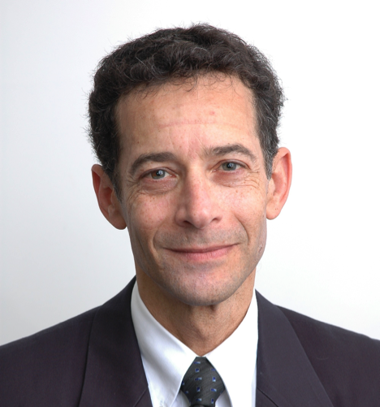
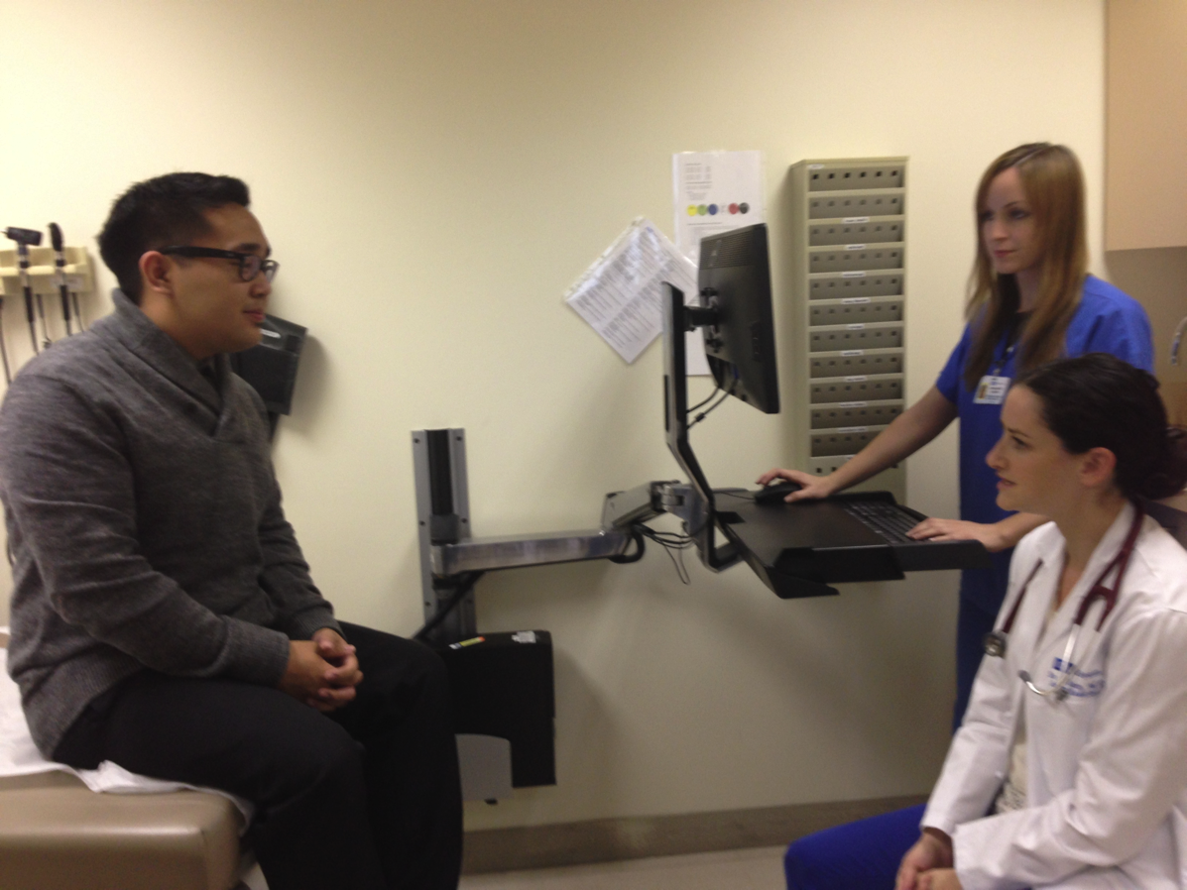
David Reuben
UCLA
Innovation
ABIMF Joy 2012
“Physician Partners”
  Scripts/COE
  Charting/Charge
JAMA IM 5.14
  Pt satisfaction
  w/MD time ↑
  Save 1.5 hr/4hr
Training Academy

Slide 27
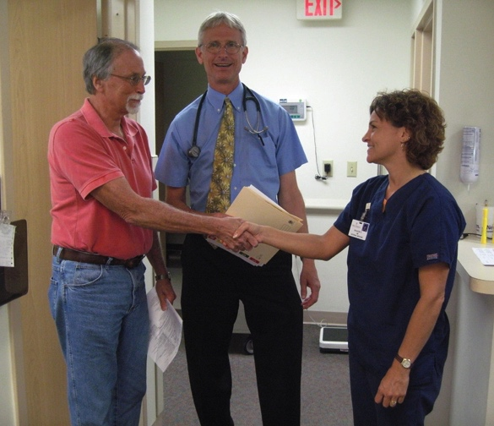
Collaborative Care
3:1

Slide 28
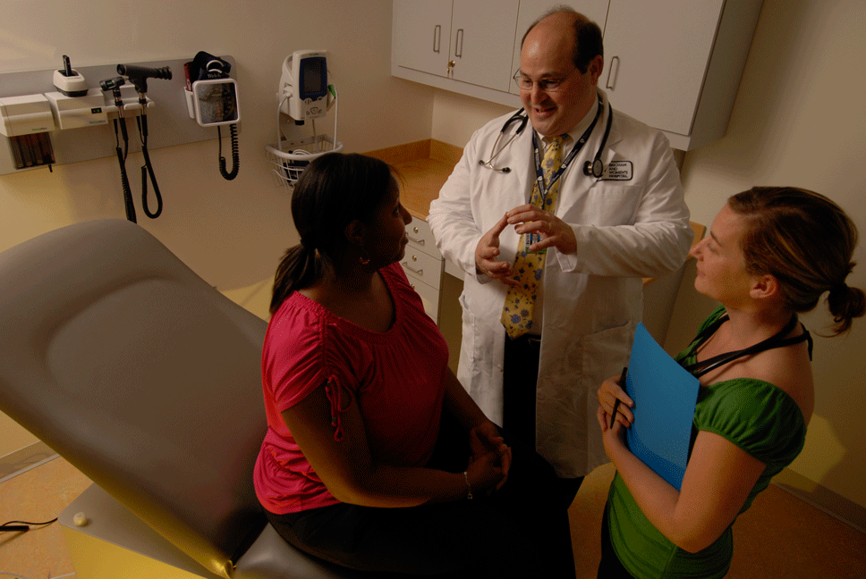
Be Bold
Action Step: Institutions

Slide 29
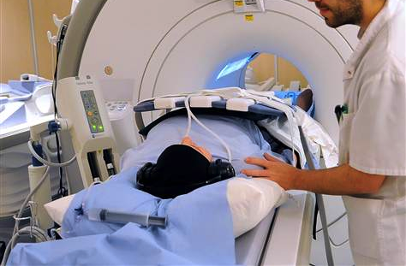
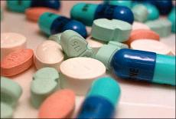
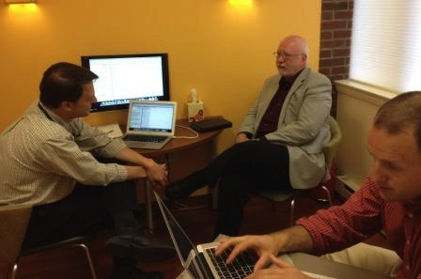
Research
Action Step
Tests
Treatment
>$100 Billion/yr
<$0.3 Billion/yr
Delivery model to wisely deploy
Notes:
overwhelming majority on tests/tx, minimal on delivery model
The NIH’s FY2014 budget request is $31.331 billion (http://www.nih.gov/about/director/budgetrequest/fy2014testimony.htm),
Tests and Treatment
$31 billion NIH
$70 billion the pharmaceutical industry spends on drug development
Xx spent on device development = $>100 billion tests and treatments
Delivery model
1 billion on health services research.
http://www.reuters.com/article/2011/06/26/pharmaceuticals-rd-idUSL6E7HO1BL20110626
http://www.fiercemedicaldevices.com/special-reports/top-10-medical-device-rd-budgets/baxter-international-top-10-medical-device-rd-budge
http://www.fiercemedicaldevices.com/special-reports/top-10-medical-device-rd-budgets/philips-healthcare-top-10-medical-device-rd-budgets

Slide 30
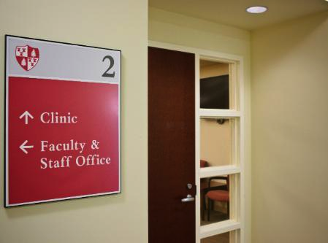
Practice Science
Action Step: Invest more in
Systems Eng.
Human Factors
Clinician
To study innovations and optimize the delivery models
Notes:
JAMA 2014 Cassel, PCAST

Slide 31
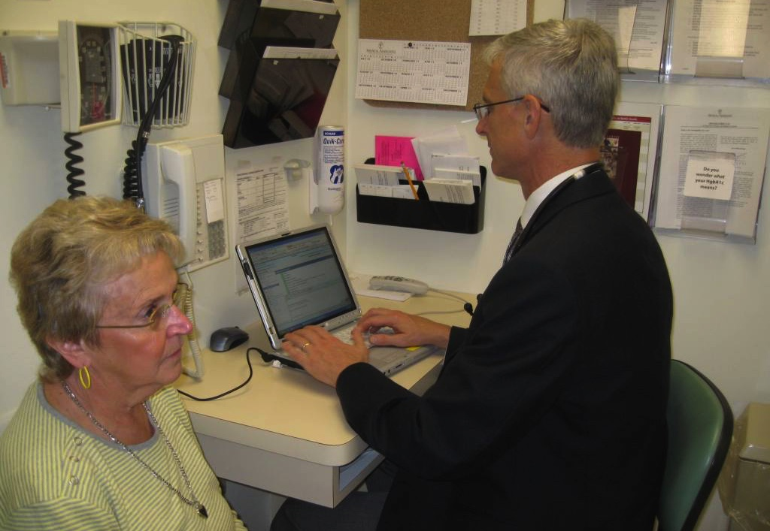
Avoid Compliance Creep
Action Step: Institutions
Ex: MU CPOE
Notes:
MDs are overwhlemed with the clerical work that makes up a significant part of their daily work. The origins of this are complex. Some may begin at the federal regulatory level, be enabled by the EHR, and then be exacerbated by hyper-interpreation of those policies at the local level, often driven out of fear.

Slide 32

Rethink Signature
Action Step: Regulators
Rethink documentation
  Most doesn’t add value
  Dr not data entry
  Serving multiple purposes
  is causing unintended consequences (show ex earlier of current documentation)

Slide 33

Less is More
Action Step: Measure Developers
Keep it simple, add it up
Notes:
Keep it simple, and add it up. Keep the measures and regulations simple and add up the total time for compliance across domains.

Slide 34
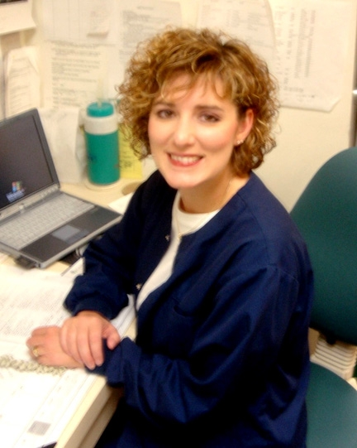
↑ Nursing Workforce
Action Step: Educators
Notes:
Our nursing colleagues have a lot to offer, and I believe have been an underutilized resource in ambulatory care. Our NPs and MDs need clinical assistants who have the skills, knowledge and licensed authority to do the work that needs to be done.

Slide 35

Relentless Focus Usability
Action Step: Vendors
Vibrant community of start-ups EHR bolt-on apps
Notes:
Our nursing colleagues have a lot to offer, and I believe have been an underutilized resource in ambulatory care. Our NPs and MDs need clinical assistants who have the skills, knowledge and licensed authority to do the work that needs to be done.

Slide 36

Professional Societies
Work underway
Joy in Medicine
“Patients before paperwork”
Systematic literature review impact of admin req on pts
JAMA IM 2014: 48 min/d
Member survey top 3 admin challenges
  EHR (MU)
  Quality reporting
  Obtaining insurance payment (prior auth)
Notes:
Socieites are ideally situation to help solve some of these problems, to act as conveners, bringing together physicians, policy makers, vendors and others from the private sector to help untie the knots.

Slide 37
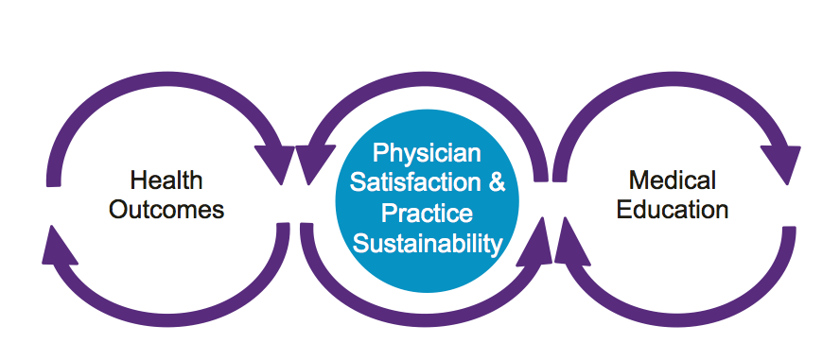
AMA’s Strategic Focus Areas
Physician
Satisfaction &
Practice
Sustainability
Health
Outcomes
Medical
Education
Rand
  Report Call to action ↑ EHR usability
  Practice transformation modules
37

Slide 38
Transformation Toolkits
Pre-visit planning
Expanded rooming
Team documentation
Prescription management
Pre-visit lab
Team meetings
PCMH/neighborhood
Lean
Transforming culture
Panel mgm’t
Resiliency
Daily huddles
EHR implementation
Inbox mgm’t
www.steps-forward.com

Slide 39


Options

Slide 40
70-80% work effort waste
Good news:
Release capacity put to better work service of pts
Re-eng workflows
Redesign how EHR integrated
↓Non-value work
Technology
Teamwork
=
Notes:
reducing the non-value added work that is clogging up the gears in practice.

Slide 41
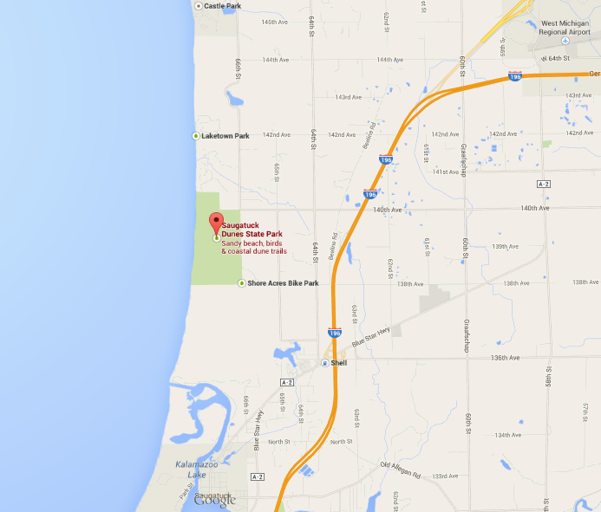

The Map is not the Terrain
Steve Martin MD and Christine Sinsky MD

Slide 42

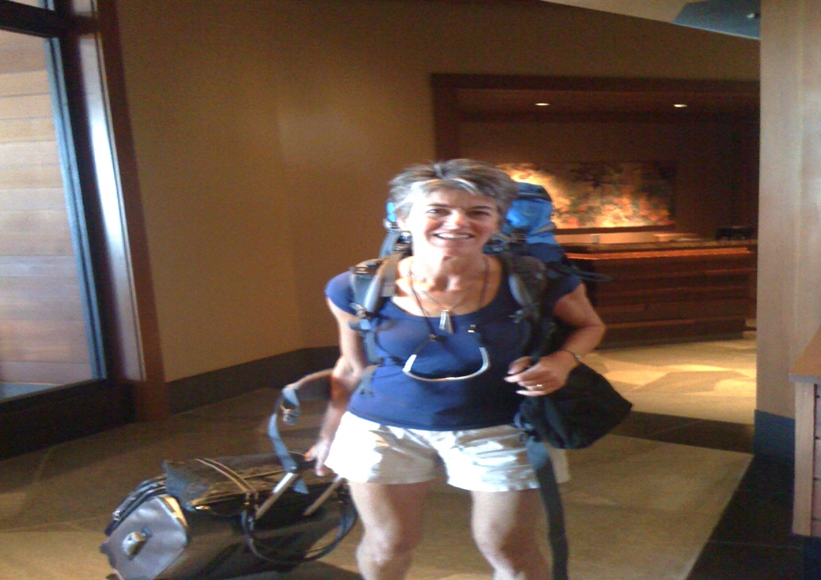
The Map is not the Terrain
"If you didn't document it, it didn't happen,"
Fresh ears are told in medical school.
But then one day we realize that documenting doing doesn’t make it so,
Experiencing makes it so.

Slide 43
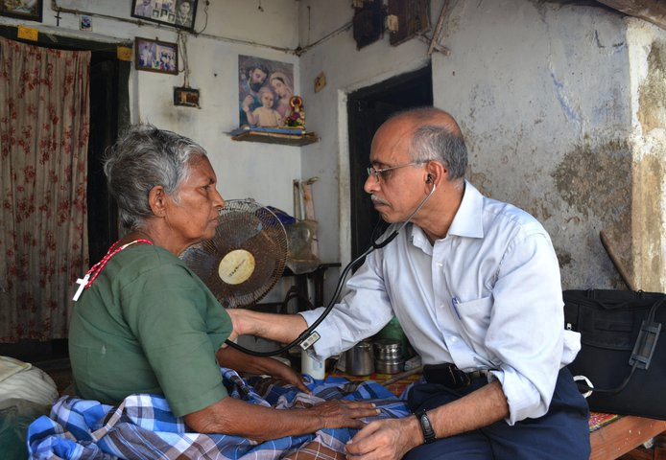
"Visited patient in her basement.
Ascites worsening as she drinks more
after death of son in motor vehicle accident."
What more should I write?
How do you document bearing witness?

Slide 44

The Code is not the Care
The Pocket Guide:
It folds like origami
and reads like computer code,
this item we received early in residency.
In small font and syllogism,
It tells us what our time with a patient is worth.
It sustains anachronisms
like the review of systems.
Three chronic conditions is the key
that opens a Level 4 lock.

Slide 45
Now we hear these notes are being poorly done.
They have too much.
They have too little.
They don’t have the right elements.
Doctors need better education.
They need more detailed notes.
We also hear there is burnout.
Access problems for patients.
People leaving primary care
or not entering it.
We hear EHRs are good.
We hear they are bad.

Slide 46
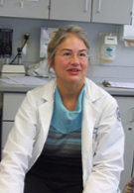
Why don’t we start at the beginning?
The care of the patient is what matters most.
The map is not the terrain.
The code is not the care.
Colleagues have left practice
Unable to keep up
with the note-production complex.
Charting encroaches on caring.
This is what happens when a means
for recording meaning
is alchemized into a tool for billing,
a means for monitoring,
a line of defense.

Slide 47
The patient-doctor “conversation”
becomes an act of distraction,
lapsed eye-contact,
and keyboard tapping.
This is pawn activity.
Finishing a patient session becomes prelude
to converting it into billable accounts.
We rush.
Patients notice.

Slide 48
The map is not the terrain.
The code is not the care.
Doctors got to where we are
because we follow rules well.
What to do then,
when the rules
erode
our doctoring?
The map is not the terrain.
The code is not the care.

Slide 49
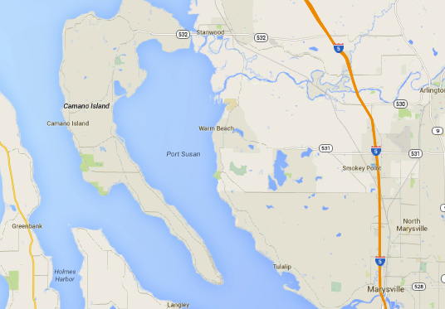

The Map is not the Terrain

Slide 50
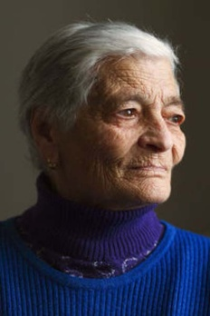
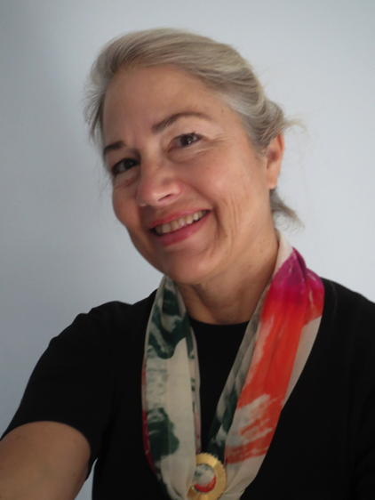
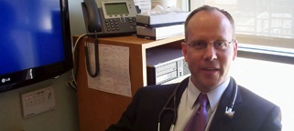
Our Work Going Forward
How can we contribute to transformation
  Working in clinic is unbearable
Entrusted and empowered by tech, team, policy; reconnect with meaning/mission
Notes:
So that our patients no longer receive care from nurses and physicians who feel that ….

Slide 51


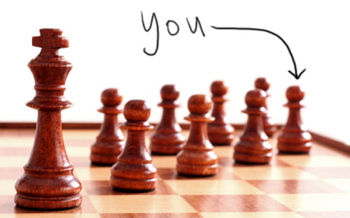
Knights, Knaves or Pawns
Collective work
I
JAMA. 2010;304(9):1009-1010 (doi:10.1001/jama.2010.1250)

Slide 52
Joy → Triple Aim
Take-away

Slide 53
Frustration in work comes from the frequent mismatch between what people must do and what people can do….. But when the match is just right, the results can be glorious.
Daniel Pink, Drive
(Autonomy, mastery, purpose)

Slide 54
When people show up to work every day passionate about their jobs there is no limit to what they can do.
Dr. Dave Moen
personal communication 8.15.14

Slide 55
Discussion
Notes:
Keep it simple and add it up. Keep the measures simple and add up the total time for compliance across all domains

